Slide 1
Occupational Specialist Component Content: Digital Production, Design and Development
The T Level T Level Technical Qualification in Digital: Digital Production, Design and Development includes a single Occupational Specialist Component. Therefore, there is a single synoptic assessment for the Occupational Specialist Component, which is an extended ‘design, development and implementation’ project. The synoptic element of the project is important in order to ensure that students are able to demonstrate threshold competence: this is the principal reason why the Occupational Specialism is assessed via a single extended project assessment to ensure that students are able to evidence all the skills required by the Performance Outcomes.
The T Level Technical Qualification in Digital: Digital Production, Design and Development Occupational Specialist Component consists of several activities grouped into four substantive tasks.
Each task will be completed during a window set by Pearson during which you will schedule supervised assessment sessions. In some cases, tasks will also involve opportunities for unsupervised activities where the requirements of the skills being assessed make this necessary.

Slide 2
Learning Objectives
Aims:
To understand how to perform a user analysis
Objectives:
To be able to select and use business analysis models to aid problem solving, including:
User stories
Activity diagrams
Mind maps
Product road maps
Process diagrams
Entity relationship diagrams

Slide 3
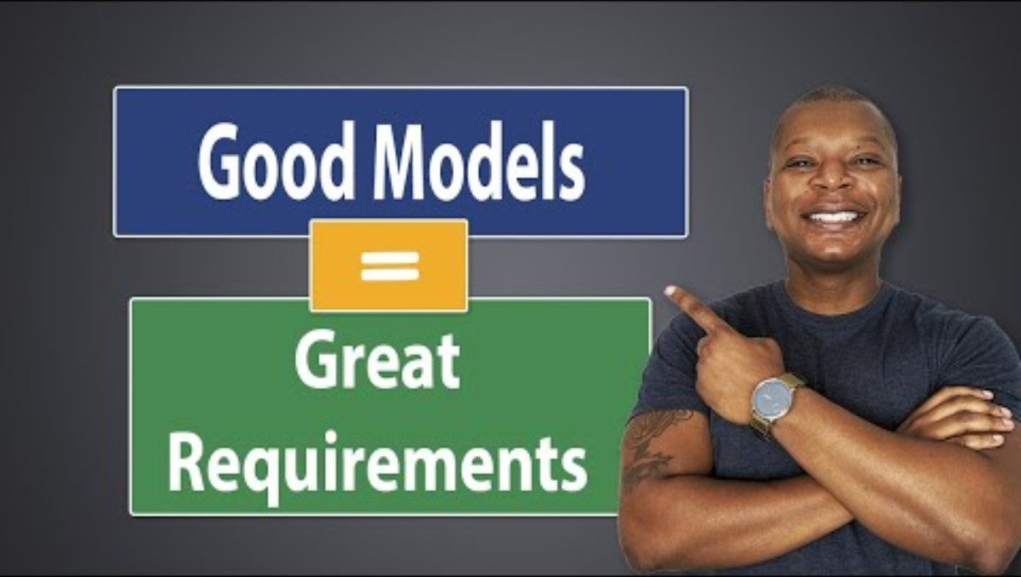
Why Use Business Analysis Models?
Purpose of Business Analysis Models:
To clarify complex business problems
To visualize systems, processes, and user interactions
To ensure clear communication between stakeholders
To support evidence-based decision making
To guide requirement gathering and solution design
Benefits:
Improved understanding of business needs
Reduced ambiguity in requirements
Faster identification of risks and opportunities
Better stakeholder alignment
Enhanced project planning and tracking
Use Models To:
Capture user needs (User Stories)
Design workflows and processes (Activity/Process Diagrams)
Organize ideas and structure (Mind Maps)
Define data structures (ERDs)
Plan feature releases (Product Roadmaps)

Slide 4
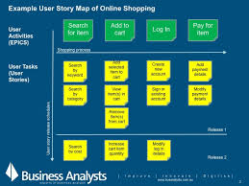

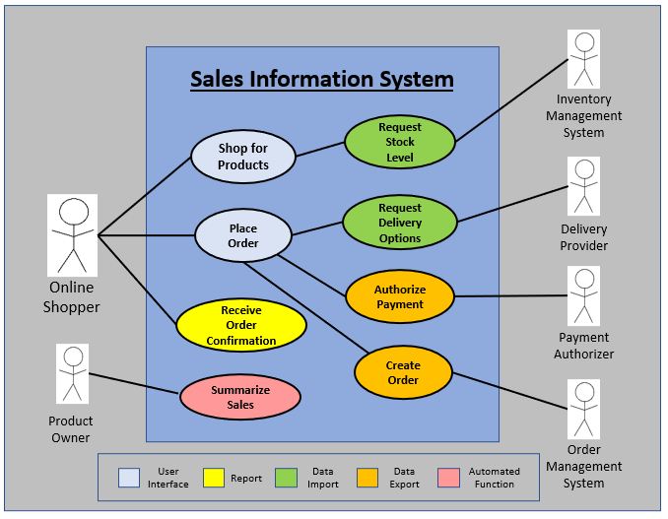
User Stories
Purpose: Capture requirements from the user’s perspective
Format: As a [type of user], I want [goal] so that [benefit]
Use When:
Defining functional requirements
Starting Agile or Scrum projects
Example: As a customer, I want to track my order status so that I stay informed about delivery.
Notes:
https://www.atlassian.com/agile/project-management/user-stories
https://www.romanpichler.com/blog/10-tips-writing-good-user-stories/

Slide 5
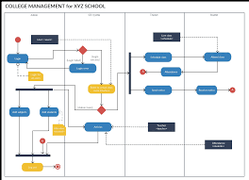
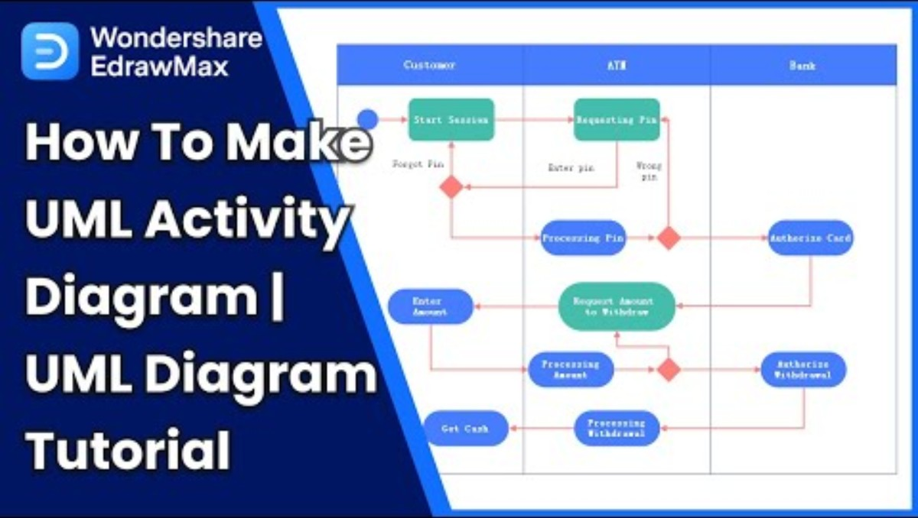
Activity Diagrams
Purpose: Show the flow of activities in a process
Use When:
Mapping user interactions or workflows
Identifying bottlenecks or redundant steps
Key Elements:
Actions
Decisions
Start/end points
Tools: UML modelling tools like Lucidchart, Visual Paradigm

Slide 6
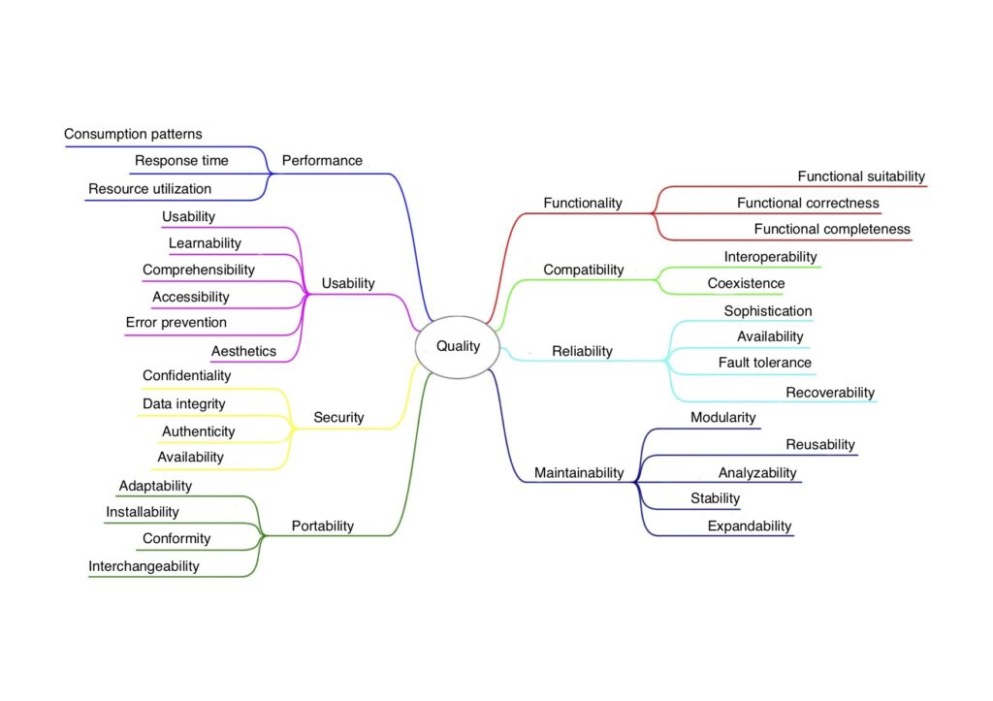
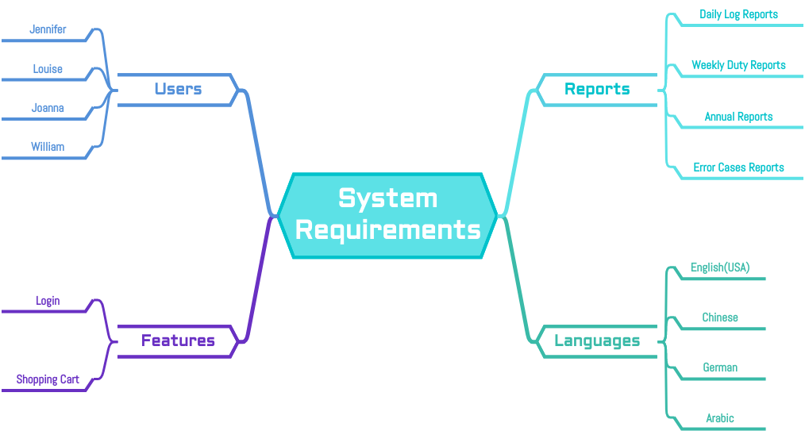
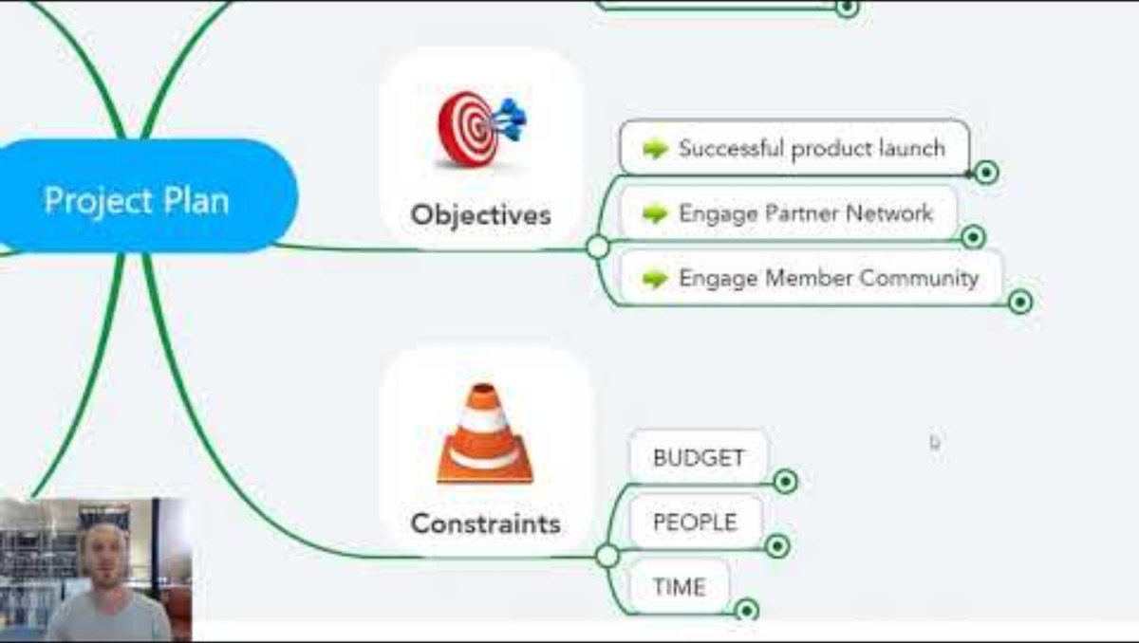
Mind Maps
Purpose: Organize ideas around a central concept
Use When:
Brainstorming
Structuring project requirements
Planning product features
Benefits:
Visual clarity
Hierarchical organization
Tools: XMind, MindMeister, FreeMind
Notes:
https://www.youtube.com/watch?v=oVfw8Oj-uH8
https://online.visual-paradigm.com/diagrams/templates/mind-map-diagram/mind-map-example-system-requirements/;VPSESSIONID=542461DC4C50DA7839371FBF7AA02CD4

Slide 7
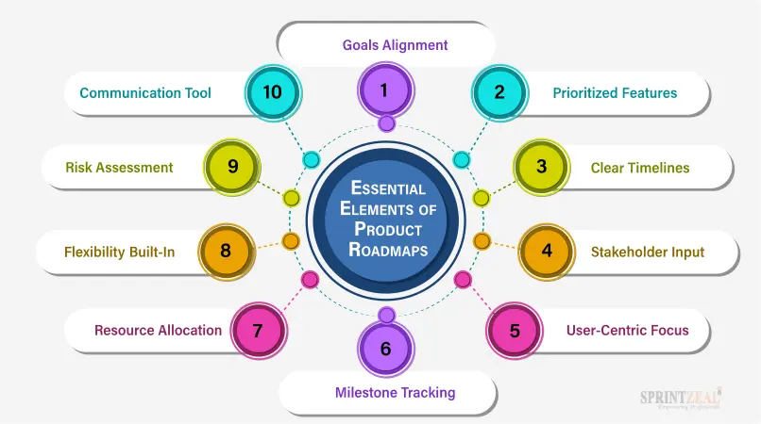

Product Road Maps
Purpose: Show product vision and timelines
Use When:
Communicating long-term goals
Planning releases and features
Includes:
Milestones
Epics/initiatives
Timeframes
Tools: Aha!, Trello, Jira Roadmaps
Notes:
https://www.sprintzeal.com/blog/product-roadmap

Slide 8
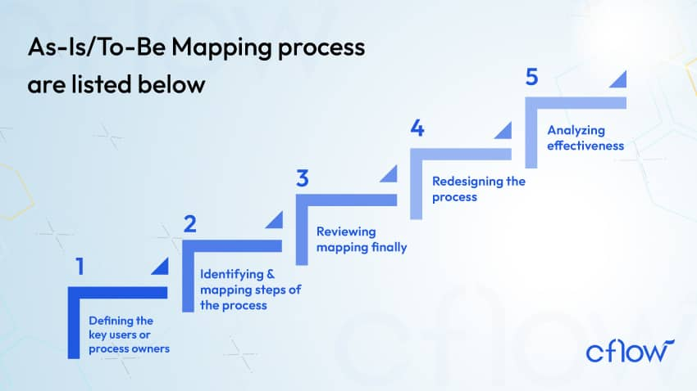
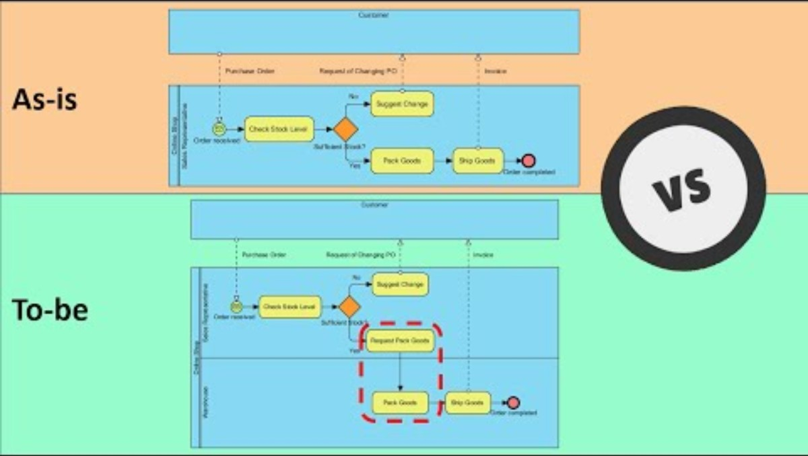
Process Diagrams
Purpose: Visualize how a process works
Use When:
Understanding current operations (As-Is)
Designing improved workflows (To-Be)
Types:
BPMN
Flowcharts
Tools: Bizagi, Visio, Draw.io
Notes:
https://www.agilitysystem.net/insight/as-is-to-be-process-mapping/
https://miro.com/blog/as-is-to-be-process-mapping/
https://www.lucidchart.com/blog/as-is-process-analysis
https://www.youtube.com/watch?v=xpLxNoD41pk

Slide 9
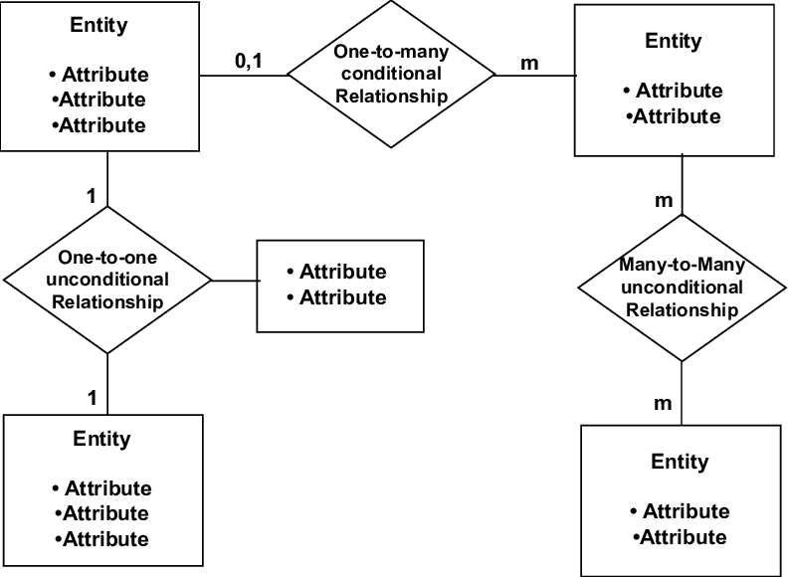

Entity Relationships Diagrams (ERDs)
Purpose: Model data and relationships in a system
Use When:
Designing databases
Structuring system architecture
Elements:
Entities (e.g., Customer, Order)
Relationships (one-to-many, etc.)
Attributes
Tools: MySQL Workbench, dbdiagram.io
Notes:
https://www.youtube.com/watch?v=BaN7Ng7a82Y

Slide 10
How to Select the Right Model
Situation | Recommended Model
Defining user needs | User Stories
Visualizing workflows | Activity Diagram, Process Diagram
Brainstorming ideas | Mind Map
Planning feature rollout | Product Roadmap
Designing data structure | ERD
Use the right model for the right purpose
Models aid in clarity, communication, and analysis
Combine models for deeper insight (e.g., user stories + ERDs)
Keep models updated throughout the project lifecycle

Slide 11
Activity1 - Build a Business Scenario (Mind Maps + User Stories)
Objective: Create user stories and a mind map for a fictional product.
Instructions:
Form teams of 3–5 students.
Scenario Prompt: “Your team is designing a mobile app for a local gym to improve member engagement.”
Each team must:
Create a Mind Map identifying key app features (e.g., class booking, trainer messaging, fitness tracking).
Write 3–5 user stories for the most important features.
Deliverables:
A poster or digital board with the Mind Map
A short list of user stories
Notes:
Time: 25 minutes Tools: Paper/markers, Miro, Lucidchart, or Mural
teams present one of their models to the class and explain:
Why they chose specific tools
What they learned from using them

Slide 12
Activity 2: Model the Process (Activity Diagram + Process Diagram)
Objective: Compare activity and process diagrams to map a system.
Instructions:
Scenario Prompt: “A customer orders a coffee through a mobile app.”
Each team:
Creates an Activity Diagram showing the steps from order to delivery.
Creates a Process Flow Diagram of the internal operations (barista, cashier, system checks).
Discussion Questions:
Where are decision points?
How do the diagrams differ in focus?
Deliverables:
Both diagrams with brief labels
Key differences between the models
Notes:
Time: 30 minutes Tools: Draw.io, Visio, whiteboards
teams present one of their models to the class and explain:
Why they chose specific tools
What they learned from using them

Slide 13
Activity 3: Product Design Challenge (Roadmap + ERD)
Objective: Create a roadmap and data model for a new product.
Instructions:
Scenario: “Design a web platform for managing university clubs.”
Each team must:
Draft a Product Roadmap for the next 3 releases (highlighting major features).
Create an ERD showing relationships between Clubs, Students, Events, and Memberships.
Deliverables:
Roadmap timeline (can be on paper or a digital tool)
ERD diagram (hand-drawn or tool-generated)
Notes:
Time: 30–40 minutes Tools: dbdiagram.io, Aha!, paper, Lucidchart
teams present one of their models to the class and explain:
Why they chose specific tools
What they learned from using them

